Slide 1
Quick-Sort
Presentation for use with the textbook Data Structures and Algorithms in Java, 6th edition, by M. T. Goodrich, R. Tamassia, and M. H. Goldwasser, Wiley, 2014
12.2
7 4 9 6 2 → 2 4 6 7 9
4 2 → 2 4
7 9 → 7 9
2 → 2
9 → 9

Slide 2
Quick-Sort
Quick-sort is a randomized sorting algorithm based on the divide-and-conquer paradigm:
Divide: pick a random element x (called pivot) and partition S into
L elements less than x
E elements equal x
G elements greater than x
Recur: sort L and G
Conquer: join L, E and G
x
x
L
G
E
x

Slide 3
Partition
We partition an input sequence as follows:
We remove, in turn, each element y from S and
We insert y into L, E or G, depending on the result of the comparison with the pivot x
Each insertion and removal is at the beginning or at the end of a sequence, and hence takes O(1) time
Thus, the partition step of quick-sort takes O(n) time
Algorithm partition(S, p)
Input sequence S, position p of pivot
Output subsequences L, E, G of the elements of S less than, equal to, or greater than the pivot, resp.
L, E, G ← empty sequences
x ← S.remove(p)
while ¬S.isEmpty()
y ← S.remove(S.first())
if y < x
L.addLast(y)
else if y = x
E.addLast(y)
else { y > x }
G.addLast(y)
return L, E, G

Slide 4
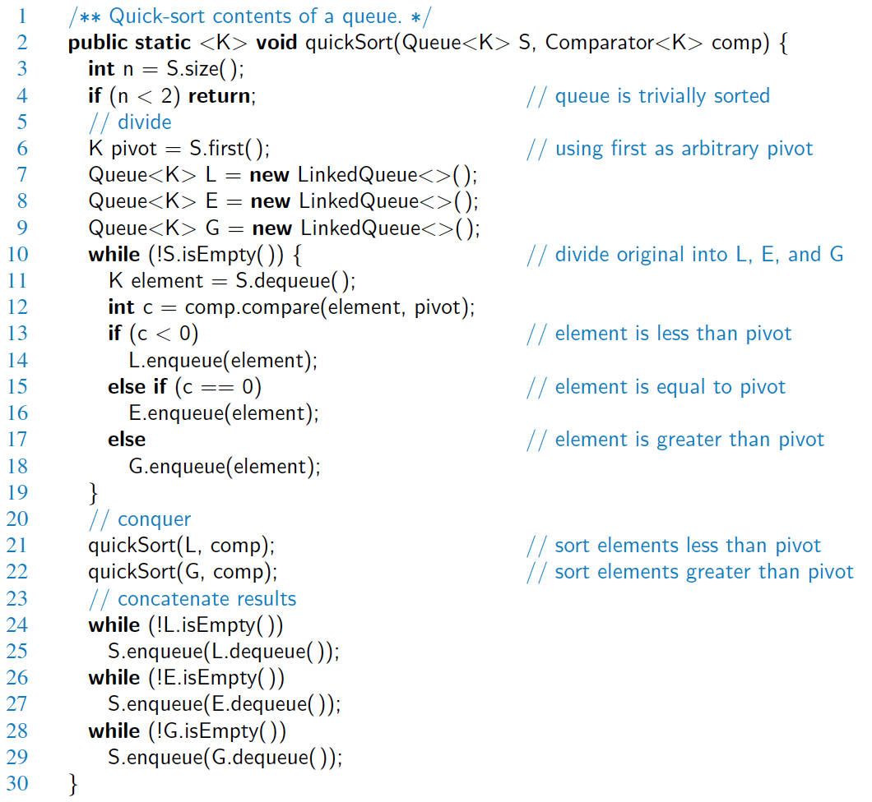
Java Implementation

Slide 5
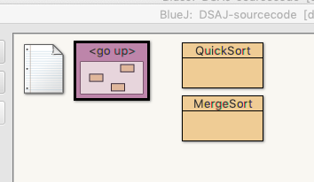
Quick-Sort Example in Java
Open up DSAJ-sourcecode with BlueJ
find package dsaj.sorting
Open file QuickSort.java

Slide 6
Quick-Sort Example
12.2.x

Slide 7
Quick-Sort Tree
An execution of quick-sort is depicted by a binary tree
Each node represents a recursive call of quick-sort and stores
Unsorted sequence before the execution and its pivot
Sorted sequence at the end of the execution
The root is the initial call
The leaves are calls on subsequences of size 0 or 1
7 4 9 6 2 → 2 4 6 7 9
4 2 → 2 4
7 9 → 7 9
2 → 2
9 → 9

Slide 8
Execution Example
Pivot selection
7 2 9 4 3 7 6 1 → 1 2 3 4 6 7 8 9
7 2 9 4 → 2 4 7 9
3 8 6 1 → 1 3 8 6
2 → 2
9 4 → 4 9
3 → 3
8 → 8
9 → 9
4 → 4

Slide 9
Execution Example (cont.)
Partition, recursive call, pivot selection
7 2 9 4 3 7 6 1 → 1 2 3 4 6 7 8 9
2 4 3 1 → 2 4 7 9
3 8 6 1 → 1 3 8 6
2 → 2
9 4 → 4 9
3 → 3
8 → 8
9 → 9
4 → 4

Slide 10
Execution Example (cont.)
Partition, recursive call, base case
7 2 9 4 3 7 6 1 → → 1 2 3 4 6 7 8 9
2 4 3 1 →→ 2 4 7
3 8 6 1 → 1 3 8 6
1 → 1
9 4 → 4 9
3 → 3
8 → 8
9 → 9
4 → 4

Slide 11
Execution Example (cont.)
Recursive call, …, base case, join
7 2 9 4 3 7 6 1 → 1 2 3 4 6 7 8 9
2 4 3 1 → 1 2 3 4
3 8 6 1 → 1 3 8 6
1 → 1
4 3 → 3 4
3 → 3
8 → 8
9 → 9
4 → 4

Slide 12
Execution Example (cont.)
Recursive call, pivot selection
7 2 9 4 3 7 6 1 → 1 2 3 4 6 7 8 9
2 4 3 1 → 1 2 3 4
7 9 7 1 → 1 3 8 6
1 → 1
4 3 → 3 4
8 → 8
9 → 9
9 → 9
4 → 4

Slide 13
Execution Example (cont.)
Partition, …, recursive call, base case
7 2 9 4 3 7 6 1 → 1 2 3 4 6 7 8 9
2 4 3 1 → 1 2 3 4
7 9 7 1 → 1 3 8 6
1 → 1
4 3 → 3 4
8 → 8
9 → 9
9 → 9
4 → 4

Slide 14
Execution Example (cont.)
Join, join
7 2 9 4 3 7 6 1 → 1 2 3 4 6 7 7 9
2 4 3 1 → 1 2 3 4
7 9 7 → 17 7 9
1 → 1
4 3 → 3 4
8 → 8
9 → 9
9 → 9
4 → 4

Slide 15
Quick-Sort Running Time
12.2.x

Slide 16
Worst-case Running Time
The worst case for quick-sort occurs when the pivot is the unique minimum or maximum element
One of L and G has size n − 1 and the other has size 0
The running time is proportional to the sum
n + (n − 1) + … + 2 + 1
Thus, the worst-case running time of quick-sort is O(n²)
depth | time
0 | n
1 | n − 1
… | …
n − 1 | 1
…

Slide 17
Expected Running Time
Consider a recursive call of quick-sort on a sequence of size s
Good call: the sizes of L and G are each less than 3s/4
Bad call: one of L and G has size greater than 3s/4
A call is good with probability 1/2
1/2 of the possible pivots cause good calls:
7 2 9 4 3 7 6 1 9
7 2 9 4 3 7 6 1
2 4 3 1
7 9 7 1 → 1
1
7 2 9 4 3 7 6
Good call
Bad call
1 2 3 4 5 6 7 8 9 10 11 12 13 14 15 16
Bad pivots
Good pivots
Bad pivots

Slide 18
Summary of Sorting Algorithms
Algorithm | Time | Notes
selection-sort | O(n²) | in-place slow (good for small inputs)
insertion-sort | O(n²) | in-place slow (good for small inputs)
quick-sort | O(n log n) expected | in-place, randomized fastest (good for large inputs)
heap-sort | O(n log n) | in-place fast (good for large inputs)
merge-sort | O(n log n) | sequential data access fast (good for huge inputs)

